Slide 1
ANOMALY BASED IDS USING ML
Guided By:
Prof. SMITA CHAVAN
Submitted By :
ANAND INGLE
AKSHAY CHACHARKAR
VISHAL POTGANTE
HITESH TAPADIYA

Slide 2
Contents
Definitions
Need for automated Detection
Project Vision
Types of Attacks to be detected
Proposed Model
Project Requirements
States Of Machine Development
Flow Diagram
Software Tools
Hardware Requirement
Application and future use
References

Slide 3
Definitions
Intrusion
A set of actions aimed to compromise the security goals, namely
Integrity, confidentiality, or availability, of a computing and networking resource
Intrusion detection
The process of identifying and responding to intrusion activities

Slide 4
INCREASING ATTACKS ON COMPUTER NETWORKS AND THE NEED FOR AUTOMATED DETECTION
Over the last decade, there has been significant increase in network attacks.
Explosive use of networks due to many reasons e.g. internet, wireless networks, cloud computing
Thus, malicious attacks on networks have increased year over year
Need to automate systems that detect these attacks
Based on on known attacks
But what about attacks that were not seen before
Machine learning?

Slide 5
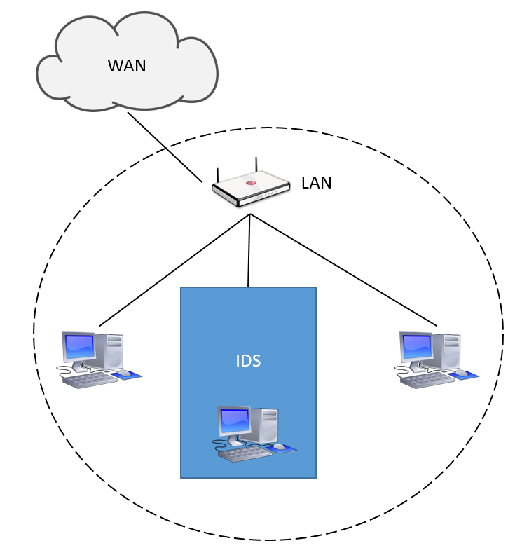
Project Vision
Intrusion Detection System
Unsupervised Anomaly based IDS
Host Based IDS
Read TCP/IP Packets
Detect Anomaly Traffic
Detect Zero day Attack
Logging System

Slide 6
TYPES OF ATTACK TO BE DETECTED
Denial of Service (DoS) Attacks
Penetration Attacks.
Scanning Attack.
Malware Attacks.

Slide 7
Proposed Model:
Output
Network Traffic
IDS
Predict System
Input
Dataset
Feature Selection
Training
Trained Model
Predication

Slide 8
Project Requirement
The System shall be able to read data from the host system network card.
The system shall be able to interpret the data from the received network traffic and store it in a usable format.
The system shall be able to determine if the network data received by the host machine is malicious with at least 85% accuracy.
The system shall determine what type of attack is being made to the host network when malicious network traffic is found.
The system shall be able to train itself through backpropagation on know network traffic data.
The system shall be able to notify the User of the host system when a malicious attack is encountered.
The system shall be able to log all malicious attacks into a log file.

Slide 9
States Of Machine Development
1. Data Import
2. Data Grouping
3. Data Normalization
4. Machine Training
5. Machine Prediction
6. Plot Anomaly
7. Detect Location

Slide 10
Data Import
Read Network Traffic
Plot The IP address and Location of Source
Plot Anomaly
Data Grouping
Data Normalization
Train Machine
Predict Anomaly

Slide 11
Software Tools
Wireshark
Spyder
Jupyter Notebook
Language’s And Framework
Python 3.6
Pandas
Plotly
Numpy
Flask, HTML Javascript and CSS

Slide 12
Phase 2.0
1. Design UI in Flask
2. Predict Location
3. Log Data

Slide 13
Hardware Requirement
ML Algorithm: Support Vector Machines (Supervised), One class Support Vector machines(Unsupervised)
Dataset: KDD1997,DARPA
Tools: Snort, Wireshark, MySQL
Language: Python, scikit-learn, Django
CPU: Intel i3 or later
OS: Windows 7 or later
SPACE:30Gb

Slide 14
APPLICATIONS AND FUTURE USE
Through this project, we aim to present a theoretical and practical model for an Intrusion Detection System using machine learning to detect and prevent known attacks as well as zero day attacks.
The system is completely automated, it gives the opportunity for organizations to save funds as the need for a network administrator is eliminated.
We try to reduced the high false Positive of current IDS system.
The System will have great UI to analyze the intrusion as well as traffic

Slide 15
REFERENCES
Machine Learning Techniques for Intrusion Detection Mahdi Zamani and Mahnush Movahedi Department of Computer Science University of New Mexico 2015
Intrusion Detection System Based On Flows Using Machine Learning by EM Kakihata - 2017
Machine learning based network intrusion detection Author(s) Chie-Hong Lee ; Yann-Yean Su ; Yu-Chun Lin ; Shie-Jue Lee -2017
Intrusion Detection System using AI and Machine Learning Algorithm Syam Akhil Repalle Venkata Ratnam Kolluru

Slide 16
Thank you…!

